Slide 1

C# Advanced – Class 2
Material recap: Classes
New material: Interfaces, Abstract classes, Polymorphism
Trainer: Igor Micev
Assistant: Dejan Blazeski
Code academy @ Skopje, 2019

Slide 2
Agenda
Abstract classes
Interfaces
Inheritance
Polymorphism
Classes (recap)
Exercising

Slide 3
Some Visual Studio tips
Tools → Options → Text Editor → C# →:
Naming
Formatting
Tabs
Scroll Bars
Advanced
…

Slide 4
Abstract classes
An abstract class provides all of the characteristics of a concrete class except that it does not permit objects of the type to be created.
An abstract class simply defines members (properties and methods) that are used for inheritance, defining the functionality of its child classes.
These members may themselves be abstract, effectively declaring a placeholder that must be implemented by subclasses. Members may also be concrete, including real functionality, and may be marked as virtual to support polymorphism via method overriding.

Slide 5
Interfaces
An interface is a code structure that is similar to an abstract class that has no concrete members (properties and methods). An interface can contain public members such as properties and methods but these members must have no functionality.
The interfaces define items that must be made concrete within all classes that implement the interface. This means that an interface can be used to define what a class must do, but not how it will achieve it.
The "I" prefix for an interface name is a recognized naming convention. E.g. IVehicle, IAnimal, IPerson, etc.

Slide 6
Inheritance
Inheritance is the ability to create a class from another class, the "parent" class, extending the functionality and state of the parent in the derived, or "child" class. It allows derived classes to overload methods from their parent class.
Inheritance is one of the pillars of object-orientation. It is the mechanism of designing one class from another and is one of the ideas for code reusability, supporting the concept of hierarchical classification. C# programs consist of classes, where new classes can either be created from scratch or by using some or all properties of an existing class.
Another feature related to inheritance and reusability of code is polymorphism, which permits the same method name to be used for different operations on different data types. Thus, C# supports code reusability by both features.
Important characteristics of inheritance include:
A derived class extends its base class. That is, it contains the methods and data of its parent class, and it can also contain its own data members and methods.
The derived class cannot change the definition of an inherited member.
The accessibility of a member in the derived class depends upon its declared accessibility in the base class.
A derived class can override an inherited member.
In C# the inherited class inherits of only one base class and can inherit from multiple interfaces.

Slide 7
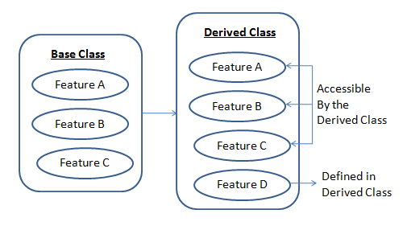
Inheritance

Slide 8
Polymorphism
Polymorphism means that a operation can also be applied to values of some other types (more definitions for polymorphism).
There are multiple types of Polymorphism:
Static (or ad-hoc) polymorphism:
Demo: Polymorphism-Static
Exercise: Task for students to resolve
Dynamic (Subtyping) polymorphism :
Demo: Polymorphism-Dynamic
Exercise: Task for students to resolve
Polymorphism with abstract classes
Demo: Polymorphism-Abstract
Exercise: Task for students to resolve
Polymorphism with virtual methods
Demo: Polymorphism-Virtual
Exercise: Task for students to resolve

Slide 9
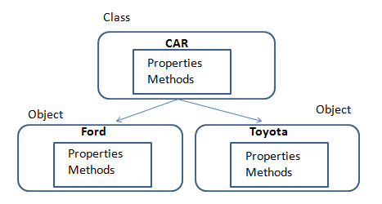
Classes (recap)
The class is the fundamental building block of code in the object-oriented programing. When an object is instantiated, it has all of the methods, properties and other behavior defined within the class.
In the real world the classes describe the objects, and the objects are the instances of them with the properties and methods defined within the classes.

Slide 10
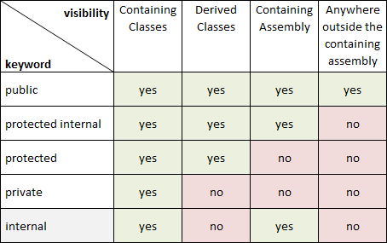
Accessors visibility matrix

Slide 11
Exercising
Trainer define a task for the students here: …

Slide 12
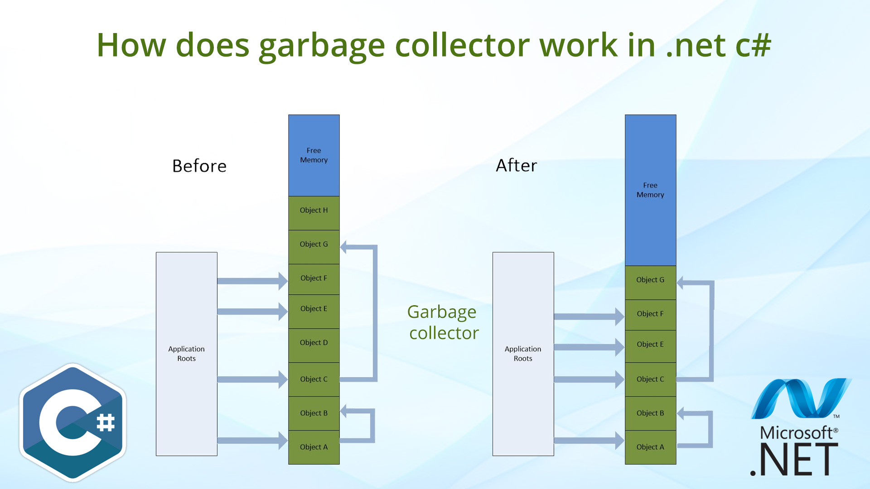
Garbage collector - Info
When objects are created they occupy some memory. As memory is a limited resource, it is important that once the objects are no longer required, they are cleaned up and their memory is reclaimed. The .NET framework uses a system of garbage collection to perform this activity automatically so that the developer does not need to control this directly.

